Slide 1
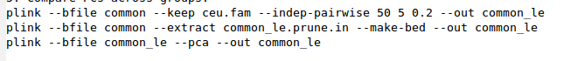
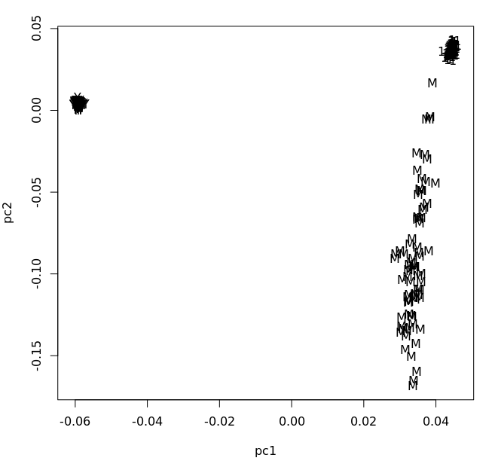

Slide 2
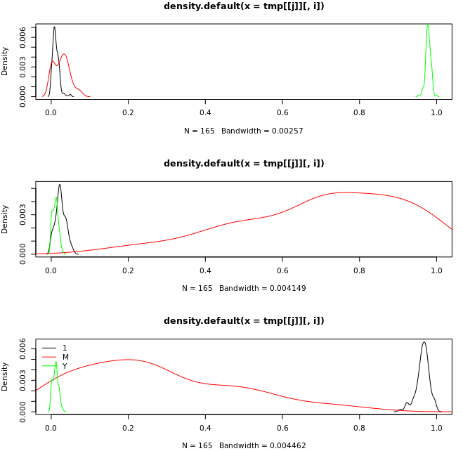
Admixture results

Slide 4

GWAS & Polygenic Scores 2016 Summer Workshop CEDUA El Colegio de Mexico, A. C.
Ben Domingue

Slide 5
Goals

Slide 6
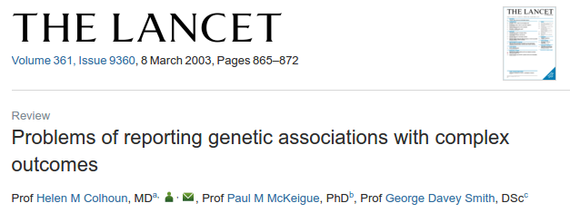
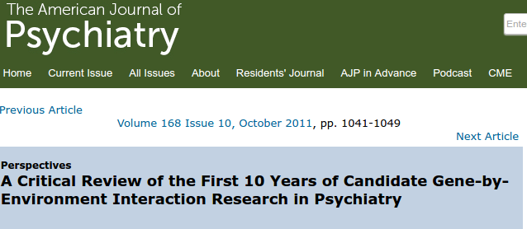
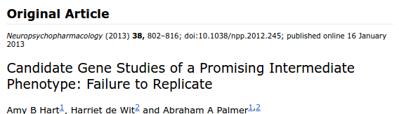
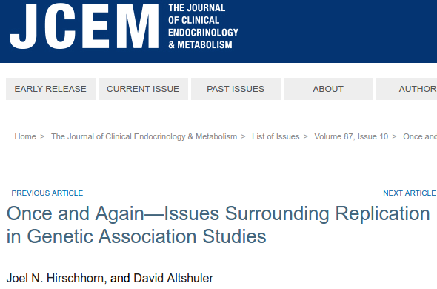
How do we link phenotypic variation to genetic variation?
First idea: candidate genes
A priori biological reason to suspect relevance.

Slide 7
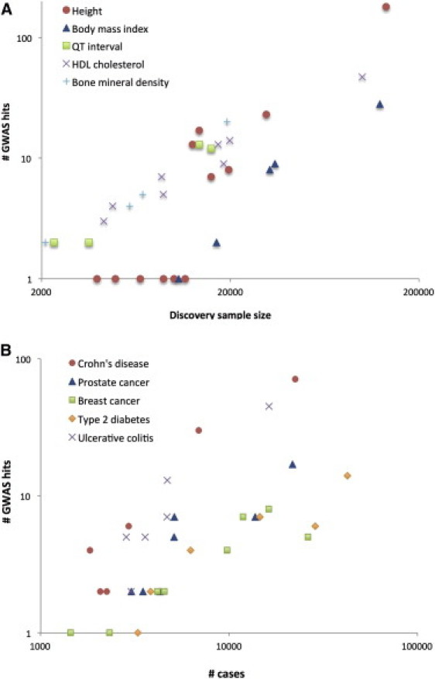
GWAS: basically data mining
Visscher et al., 2012
First, assemble LOTS of data.
Regress outcome on SNP + controls
Do this for every SNP
Look for SNPs that are sig after corrections for multiple testing (p<1e-8)

Slide 8
Theory of GWAS

Slide 9
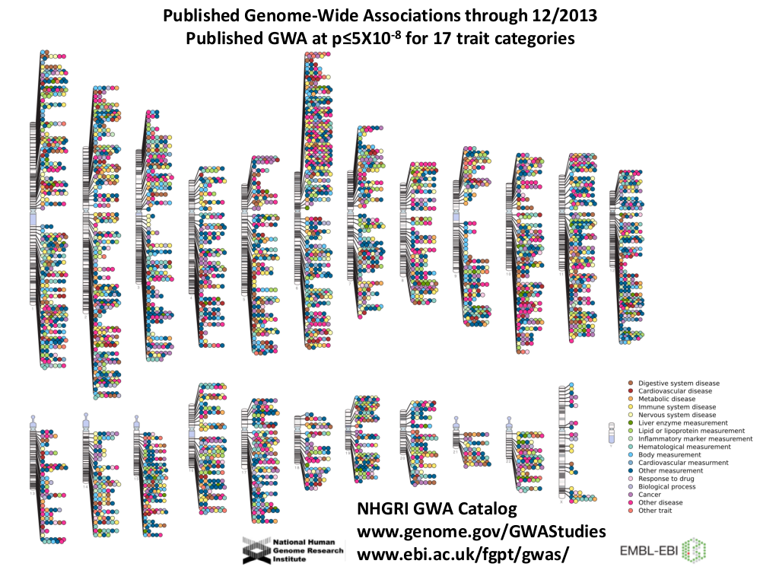

Slide 10
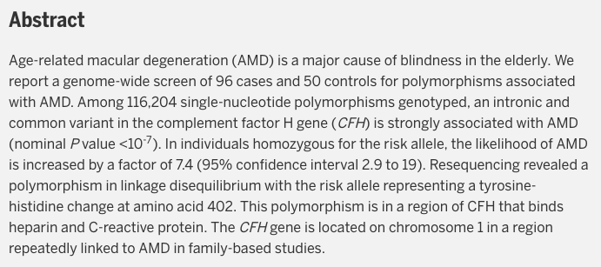
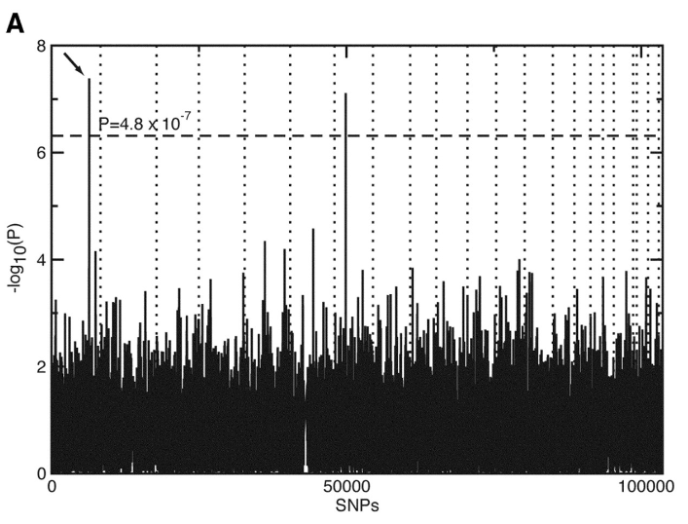
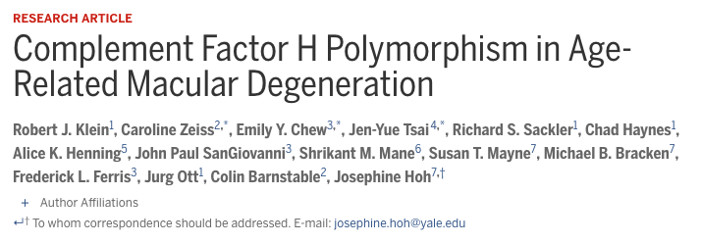
The first gwas

Slide 11
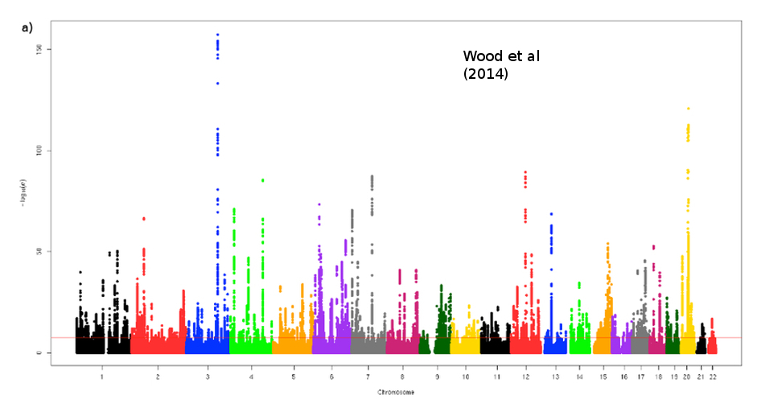
Height

Slide 12
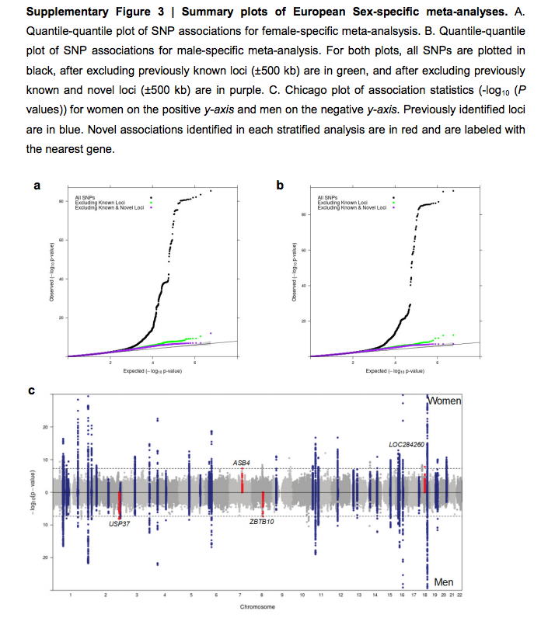
BMI (Locke et al 2015)

Slide 13
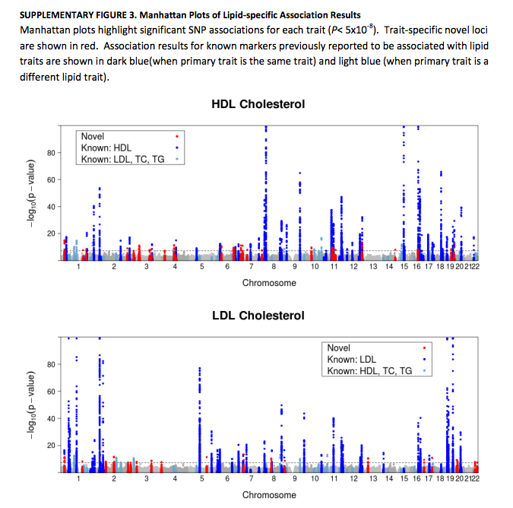
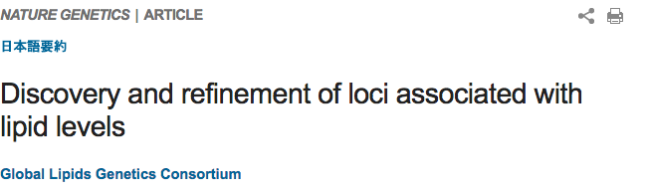

Slide 14
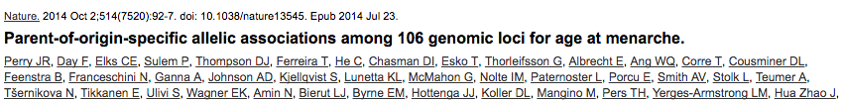
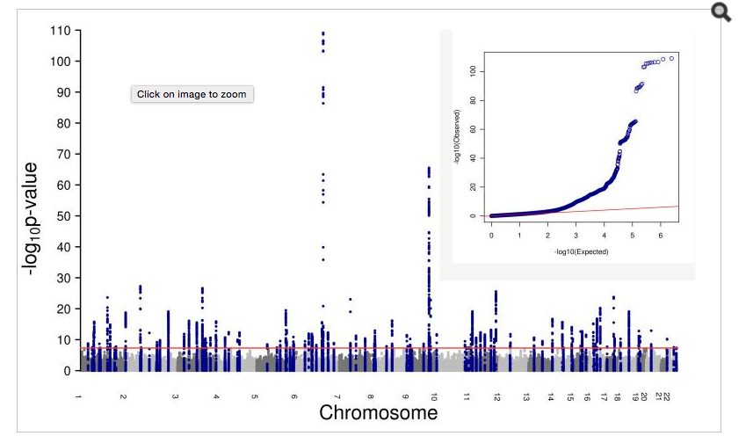

Slide 15
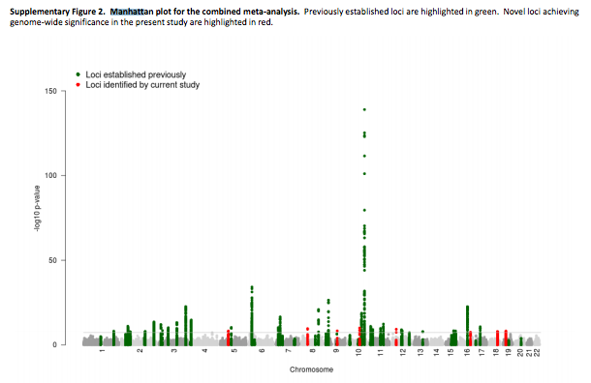
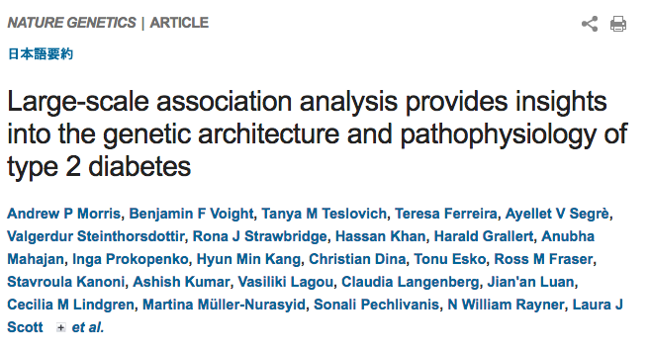

Slide 16
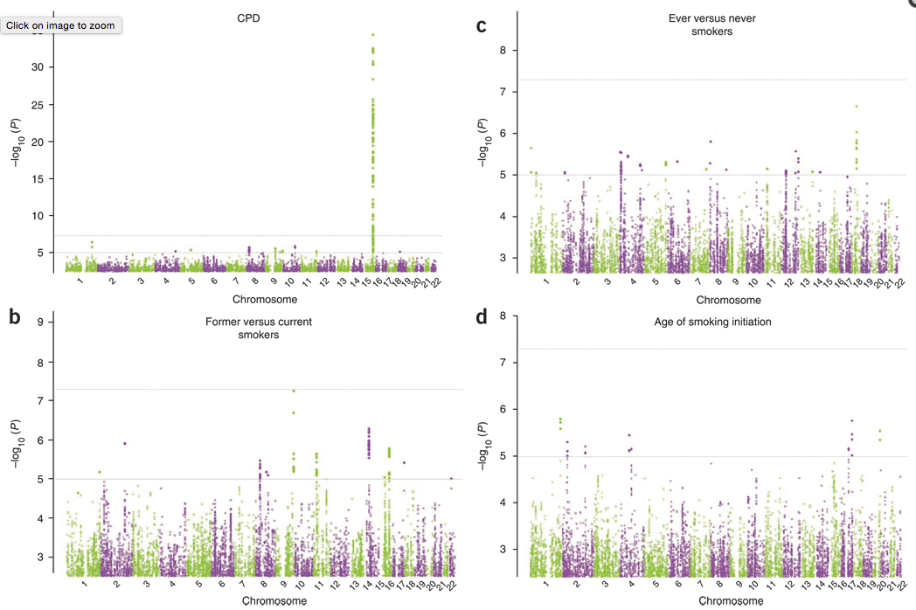
Smoking
Smoking

Slide 17
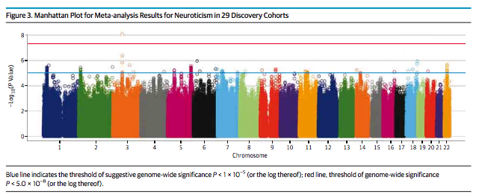
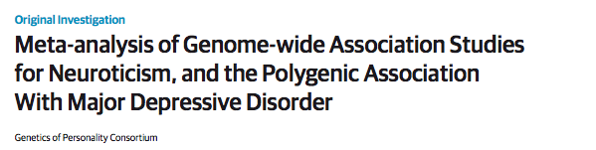

Slide 18
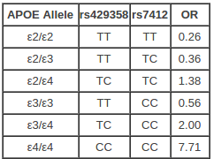
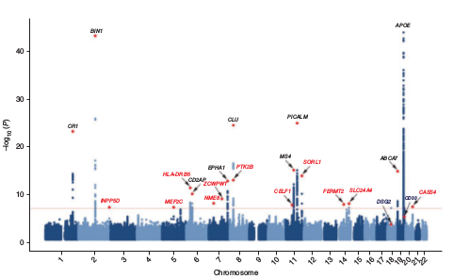
Alzheimer’s
Baseline risk:
9% M, 17% F
Source:
Genomes Unzipped
Lambert et al. 2013

Slide 19
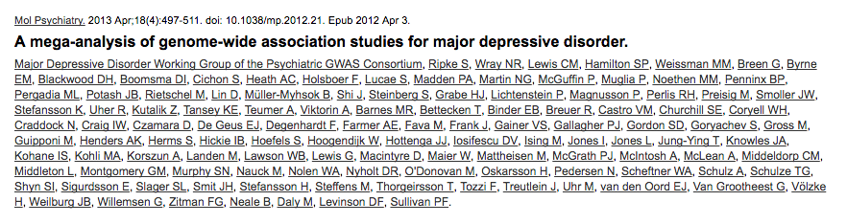
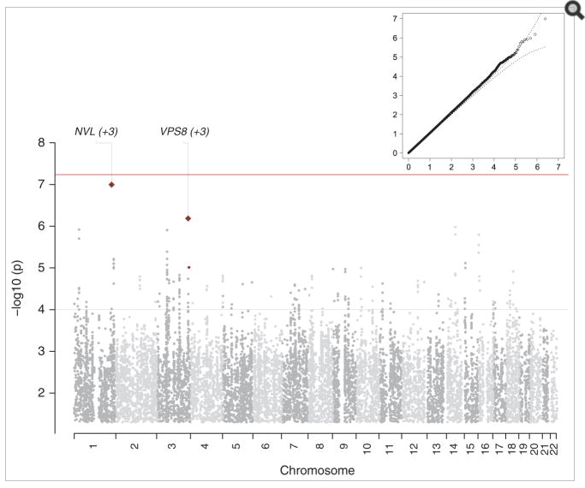

Slide 20
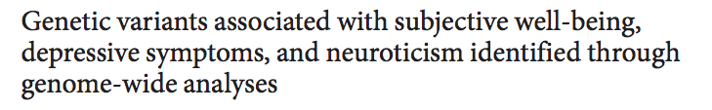
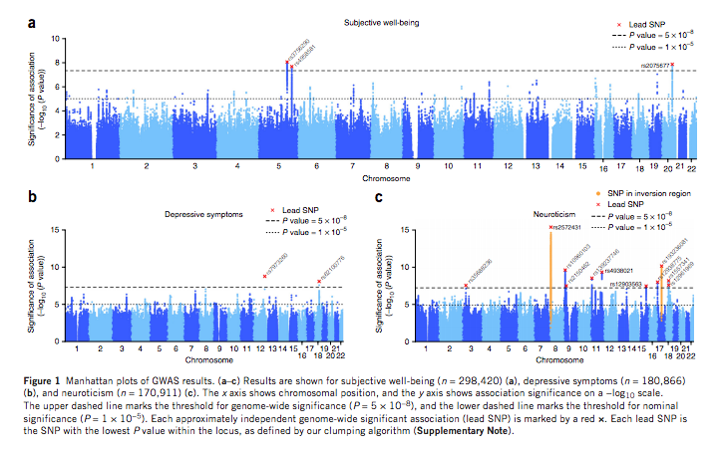

Slide 21
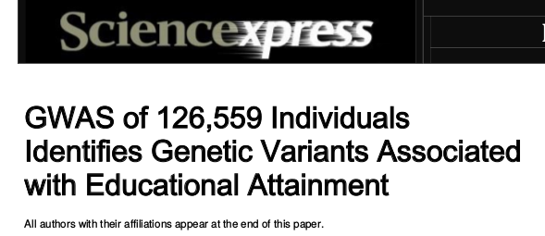
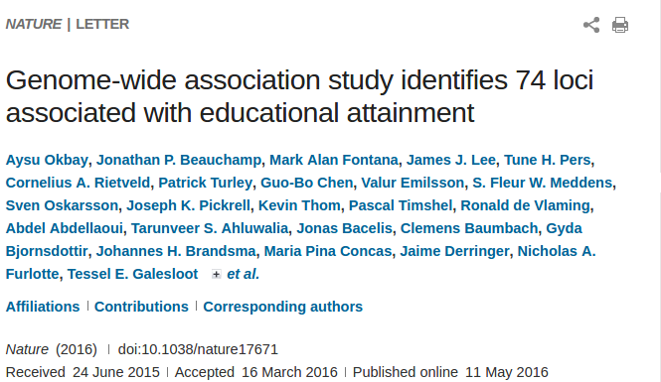
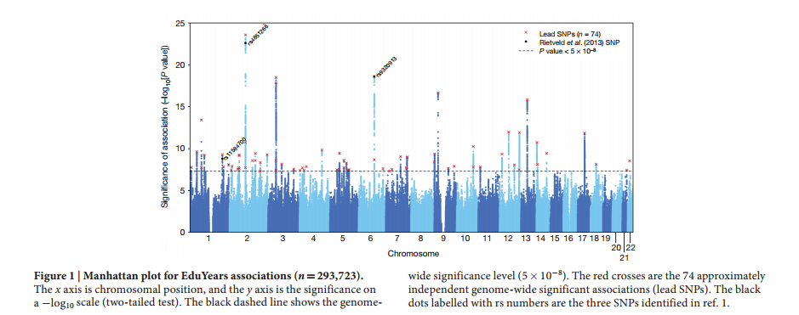
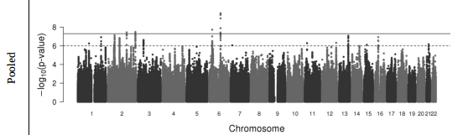
NEW!

Slide 22
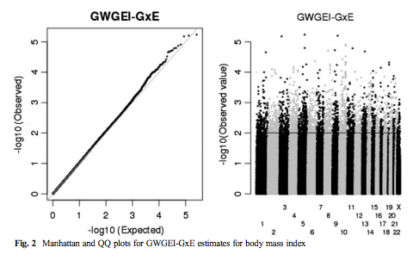
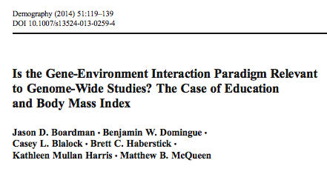
Why you shouldn’t do a gwas

Slide 23
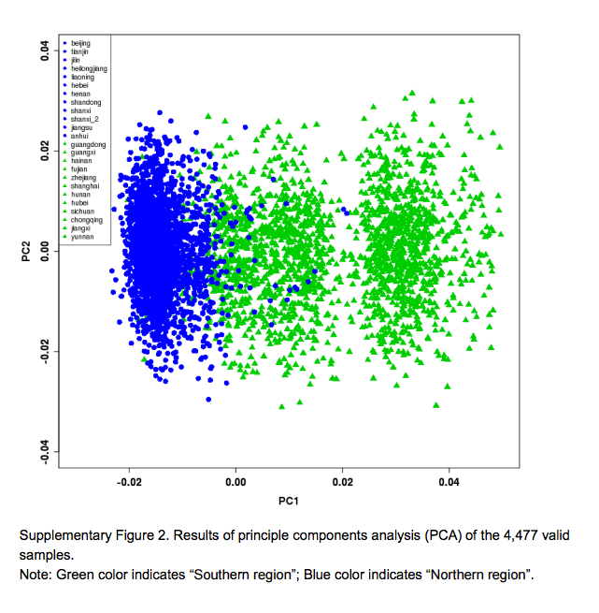
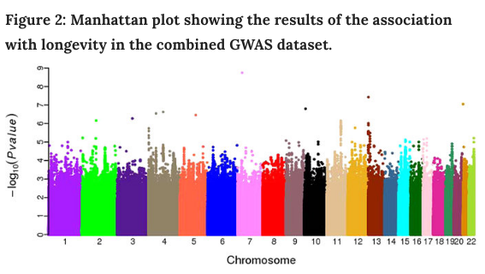
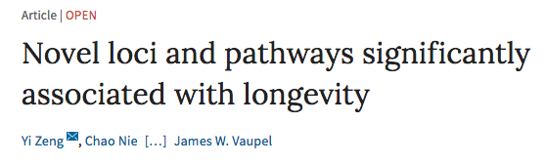
GWAS on non-European samples

Slide 24
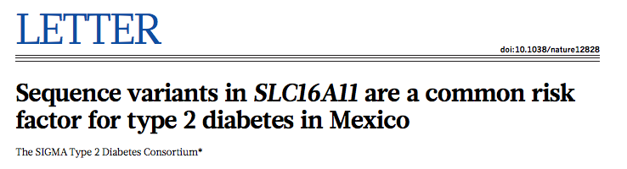
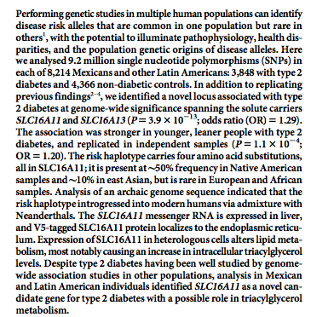

Slide 25
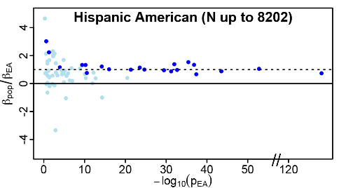
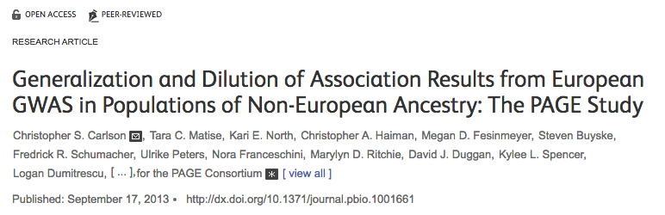
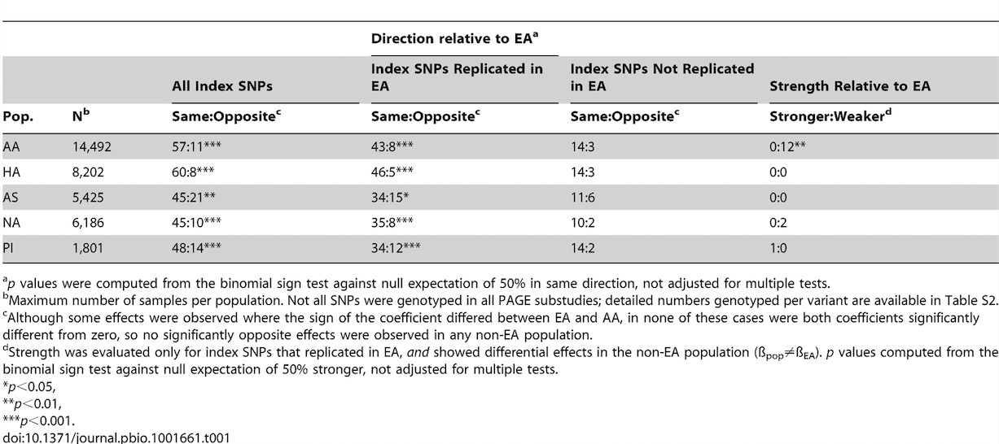

Slide 26
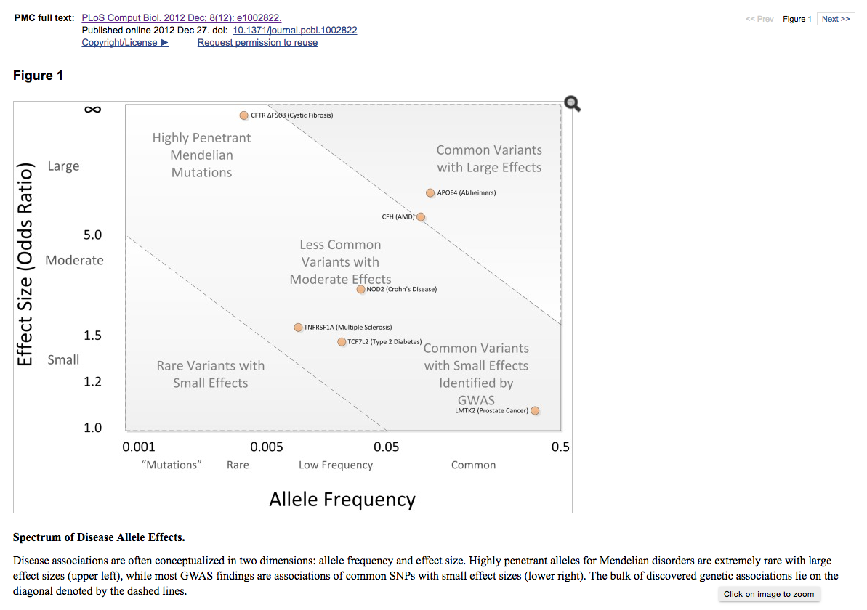
On genetic architecture

Slide 27
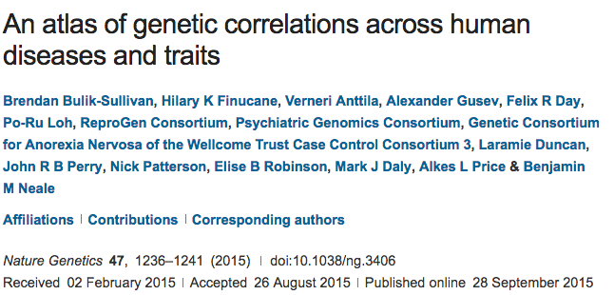
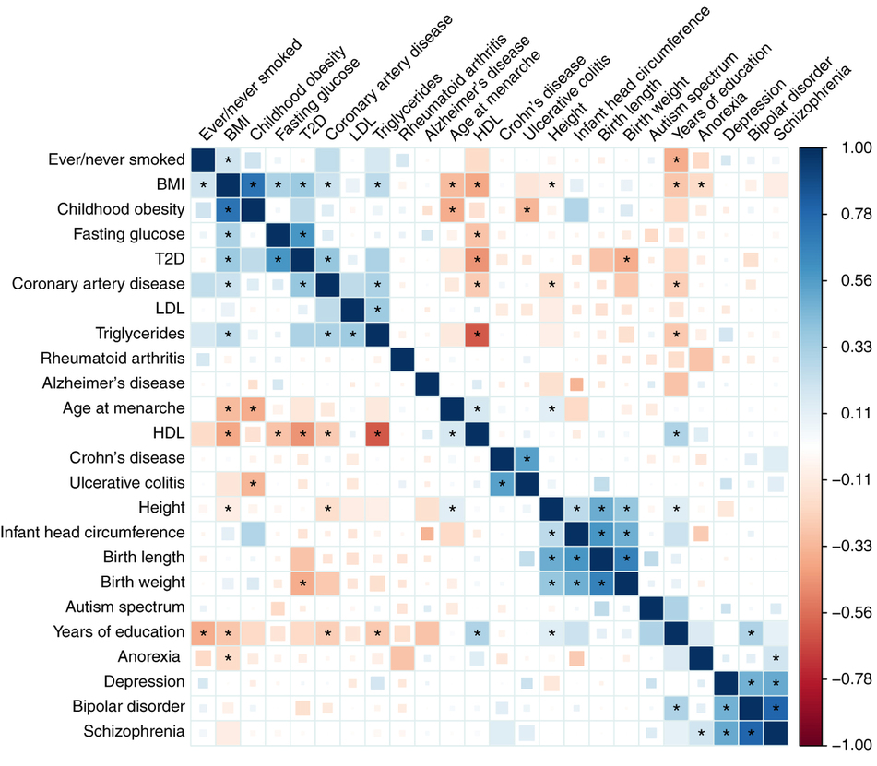
Overlapping genetic architectures

Slide 28
What are we going to do with GWAS data?
Going to demonstrate a potential line of research related to educational attainment.
Other stories could be told about bmi/smoking
BMI:
Within-family: http://journals.plos.org/plosone/article?id=10.1371/journal.pone.0101596
Cohorts: http://asr.sagepub.com/content/80/4/705.short
Development: http://archpedi.jamanetwork.com/article.aspx?articleid=1171937&goback=.gde_4173543_member_121667167
Behavioral moderators:
Sugary drinks http://www.nejm.org/doi/full/10.1056/nejmoa1203039
Fried foods http://www.bmj.com/content/348/bmj.g1610
Exercise http://journals.plos.org/plosmedicine/article?id=10.1371/journal.pmed.1000332
Smoking:
Cohorts: http://link.springer.com/article/10.1007/s10519-015-9731-9
Development: http://archpsyc.jamanetwork.com/article.aspx?articleid=1672838&resultclick=3
Environmental moderators: http://www.nature.com/tp/journal/v3/n8/abs/tp201363a.html

Slide 29
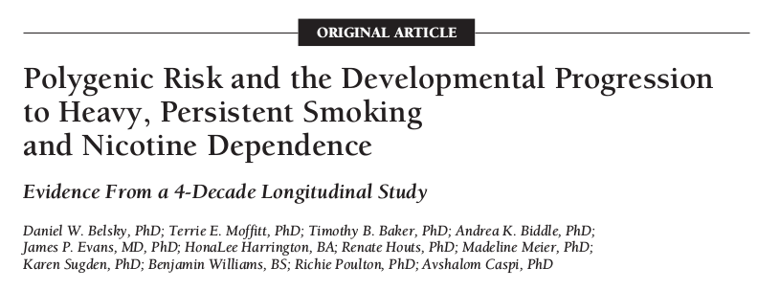
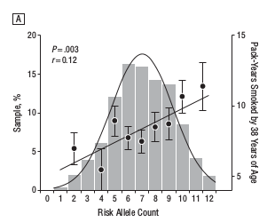
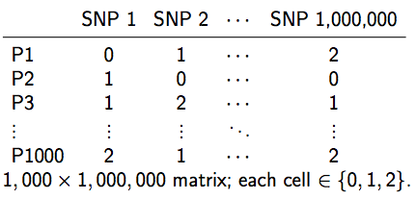
Polygenic Scores (PGS)
Like a credit score
+
They are predictors of the type we are accustomed to.
Prediction >> Description
Going to turn to issues related to PGS for EA
Question 1: how robust is their prediction?

Slide 30
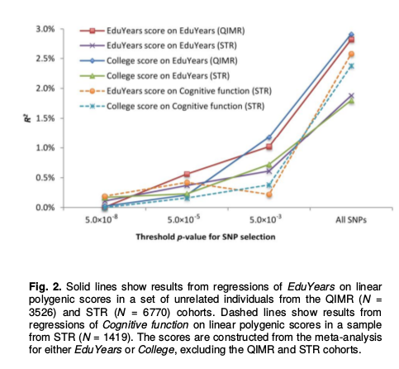
Predict out of sample
Important point given the failures of candidate gene studies!

Slide 31


Predicts net of mom’s education

Slide 32


Predicts within families

Slide 33


Predicts within families.

Slide 34


Predicts academic performance

Slide 35

One obvious pathway from genetics to educational attainment is cognition.

Slide 36


But there are other candidates.

Slide 37
Now let’s talk about construction.

Slide 38
PGS types
Top hits: only SNPs that reach some (stringent) level of statistical significance (1e-8)
Genome-wide: all SNPs or all below some nominal level of significance (0.5)

Slide 39
Hopefully you have some interesting ideas for how to use a PGS (or at the very least have been inspired to think about how one might use them).
But where do they come from?

Slide 40

Constructed by “others”
But you are limited to what they have available (can’t use new or updated results).

Slide 41
What about making your own?
Hopefully you’ll leave today equipped to do so!

Slide 42
Some things to be mindful of before we get started.
Additivity
Strand Ambiguity
Weights
LD considerations

Slide 43

Additive Model of Genetic effects
In general, GWAS attempt to identify additive (as opposed to dominant or recessive) genetic effects.

Slide 44

Ambiguous strands

Slide 45

GWAS Results
Empirical Data
1 rs3934834 0 1005806 A G

Slide 46

Strand issues
Paired bases: A-T, C-G
Fwd strand A/C implies reverse strand T/G
Suppose GWAS identifies A as risk allele. [note: they may not give you other allele.]
Your data:
What base in your data will be equated to the A in GWAS results?

Slide 47
Strand issues
In “top hits” scores, you can try to determine what is going on via comparison of allele frequencies to some kind of reference.
Authoritative info hard to come by (and needs to be population specific).
Not going to work if allele frequencies aren’t easily distinguished.
Very nasty issue, but I have some workarounds.

Slide 48
Weights
Each SNP will be weighted by the magnitude of its effect.
For continuous traits, the estimated coefficient.
For dichotomous traits, log of the OR.
If you’re doing a top-hits score, then may not need to weight.

Slide 49

LD considerations
Too many variants in linkage with a certain causal variant could lead to overemphasis of that region in the PGS
Instead of LD pruning, LD clumping:
Select variants in LD blocks that are most highly associated with outcome.
LDpred:

Slide 50
Research #3
Before we look specifically at how to make scores, let’s take a new look at research projects.
Data access is likely to be an issue. Outline the steps one may need to go through to get access to the data of interest.

Slide 51

Let’s make some scores
We are going to make scores using some of my homemade software:
https://github.com/ben-domingue/HeritHelper
Other options exist:

Slide 52

make_pgs()
Homebrewed function to create a pgs.
Available at https://github.com/ben-domingue/HeritHelper/blob/master/R/make_pgs.R

Slide 53
4 Step process
Remove ambig SNPs from the GWAS file.
Clumping
Remove ambig SNPs and those removed in step 2 from plink files.
Generate polygenic score
Step 3 is really messy.

